Slide 1

THE COPPERBELT UNIVERSITY
KAPASA MAKASSA CAMPUS
SCHOOL OF NATURAL REOSURCES
DEPARTMENT OF
PLANT & ENVIRONMENTAL SCIENCES
SOIL SCIENCE
FO 240
Mr Chindi Kapemwba

Slide 2
SOIL ORGANIC MATTER (SOM)
Soil organic matter (SOM) includes plant and animal residues at various stages of decomposition, ranging from fresh undecomposed materials through partially decomposed and short-lived products of decomposition to well-decomposed humus.
With decomposition, the proportion of resistant compounds such as lignin gradually increases.
Resistant decomposition products and newly synthesized substances accumulate in soil and form complexes with its mineral components.
Humus is formed in the latter stage as a result of such continued decomposition, resynthesis, and complexation.

Slide 3
SOM cont…
Most mineral soils found in the Tropics contain < 5% of Soil organic matter by weight.
Soil organic matter (SOM) is highly variable because different organic compounds are found in different plant and animal residues and different organic compounds predominate at different stages of decomposition.

Slide 4
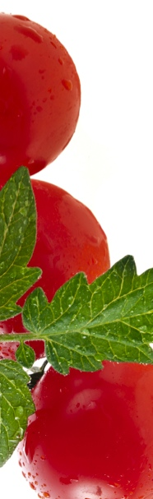
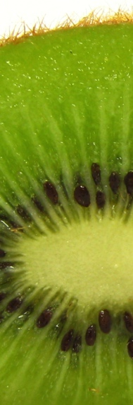
Organic material
Organic compounds have carbon as their basic element. Organic compounds come from plant material, dead animals and their transformation products found in and on the ground.

Slide 5

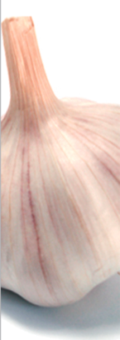
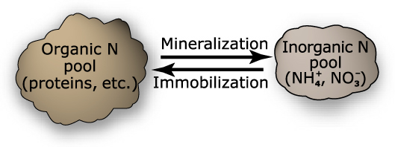
Organic material
Decomposition of organic matter:
Mineralization: Transformation of organic matter by the action of soil micro-organisms into soluble or gaseous inorganic compounds. The mineralized carbon is converted to CO².
Humification: Parts of the compounds originate in decomposition that are non-mineralized. Those parts start the formation of new complex molecules of colloidal nature and dark in colour, with a high content of carbon in their structure that is humus.

Slide 6
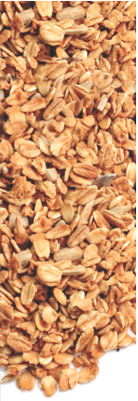
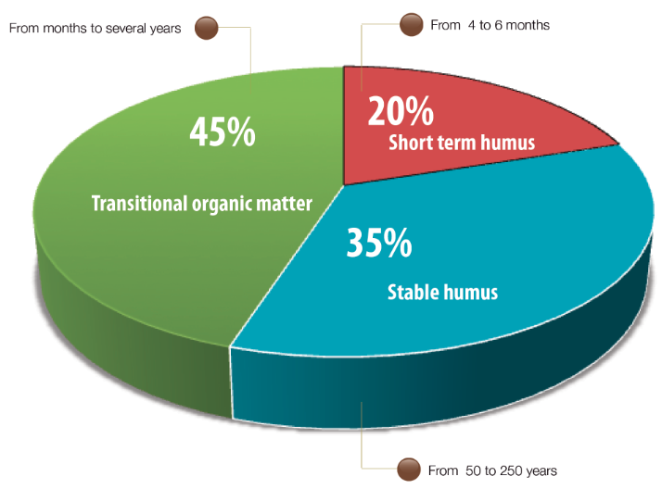

Organic material
Organic matter is material that is found in all possible phases of decomposition. From fresh waste to completely decomposed organic matter known as humus that consists of complex collodial substances (humic acids, fulvic acids and humin).

Slide 7
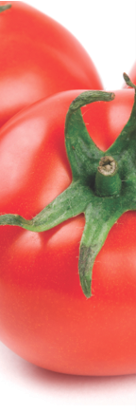
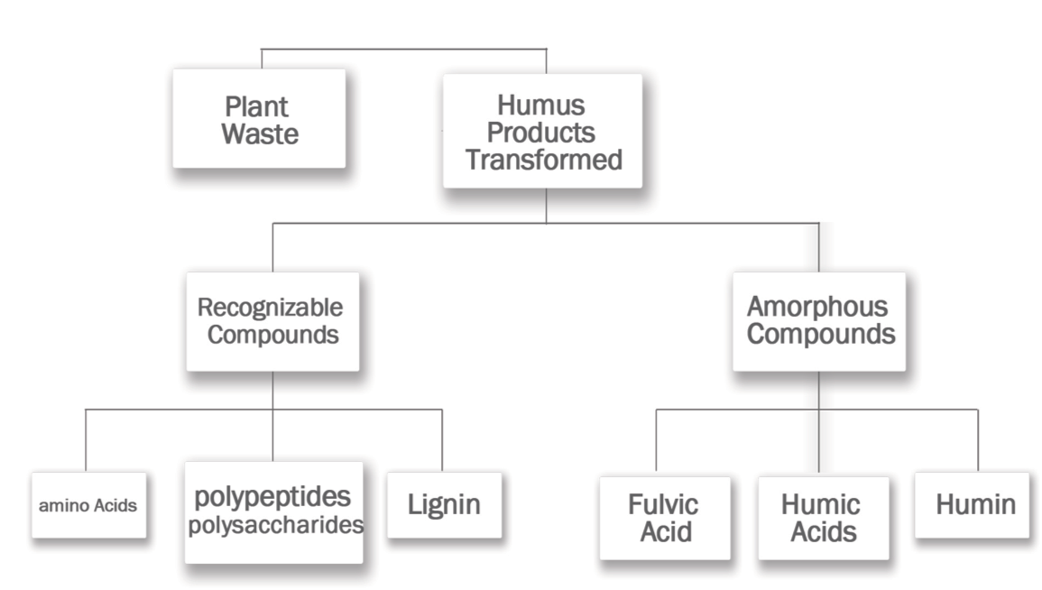
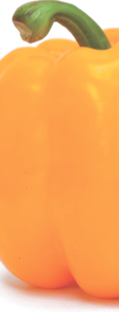
Soil organic matter

Slide 8
Fulvic Acid
Fulvic acid: Portion of the soluble compounds of organic matter in water or dilute acids.
a) Molecular weight between 1000 and 5000
b) High content of carboxyl and phenolic groups
c) High interchangeability
d) Lateral and flexible structures
e) Ability to form stable compounds with polyvalent cations such as Fe, Al, Cu etc.

Slide 9
Humic Acid
Humic acid is the soluble humus fraction in bases. This is because under alkaline conditions the carboxyl groups are negatively charged by increasing the solubility of the molecules, and precipitated in acid solution.
`
a) High level of polymerization
b) Molecular weight between 10,000 and 100,000
c) Low content of carboxyl groups (COO⁻), but higher content of aromatic groups (C₆H₅O⁻) .
d) High water absorption capacity.
e) Less CEC than fulvic acids
f) Ability to form complexes
g) Very stable clay-humus complexes due to its ability to bind to clays.

Slide 10
Humins
Humins: These are complex substances that are considered evolved from humic acids. They bind so strongly with the clay and this causes them not dissolve in alkaline reagents.
a) High molecular weight
b) High content of oxygen relative to carbon
c) Low cation exchange capacity
d) Aromatic condensed Groups
e) Structures resembling lignins

Slide 11
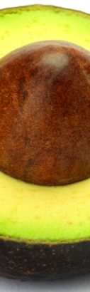
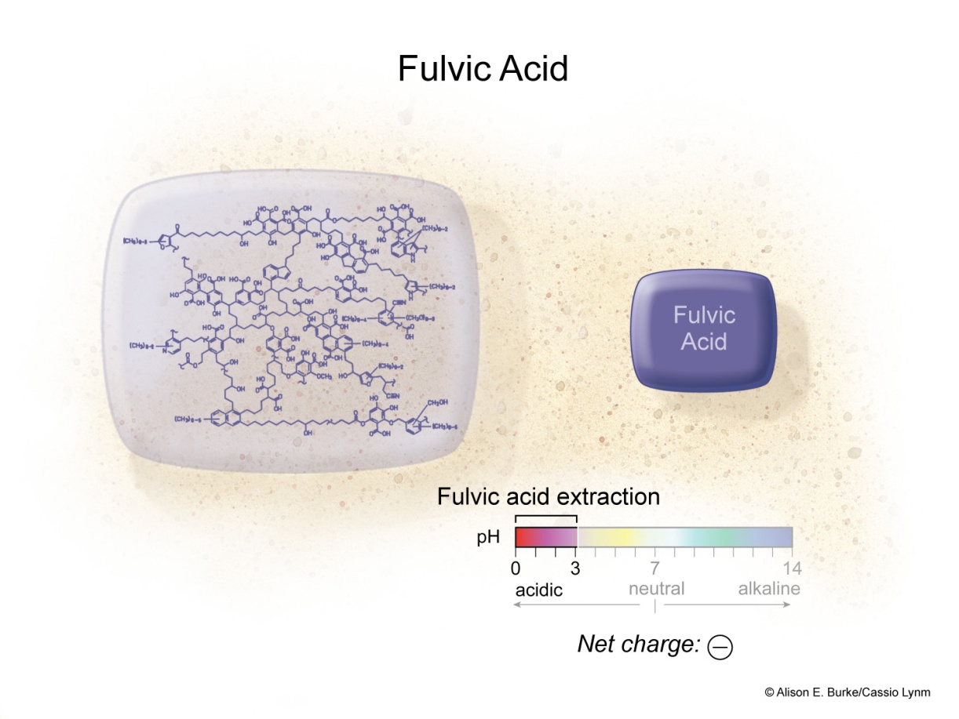
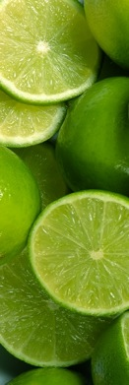
Fulvic Acid
Fulvic Acid is soluble in water and acid
Fulvic Acid can:
  Chelate Metal Ions - Complex Metal Ions
  Enhance Plant Metabolism - Enhance Microbial Activity
255

Slide 12
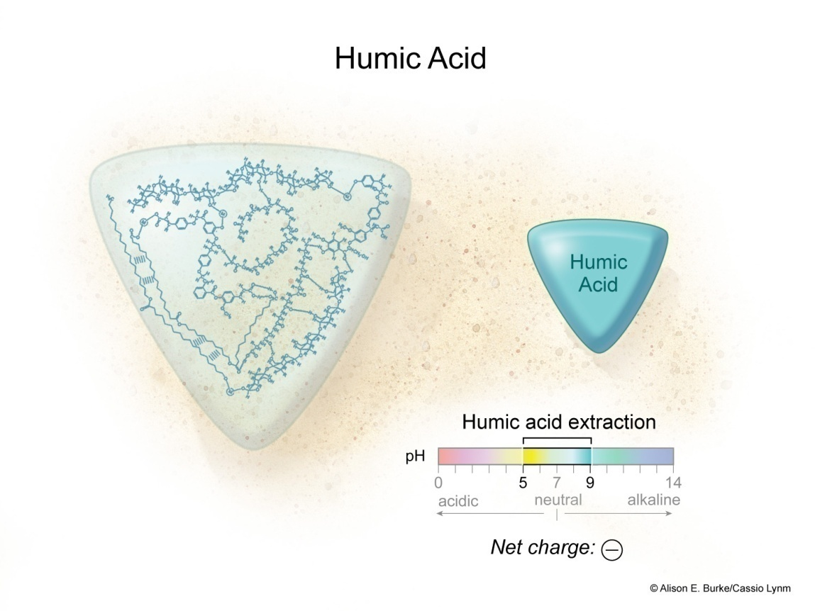
Humic Acid
Humic Acid is soluble at pH above 7.0
Humic Acid can:
  Chelate metal ions - Complex metal ions.
  Enhance soil aggregation - Enhance microbial activity.
257

Slide 13
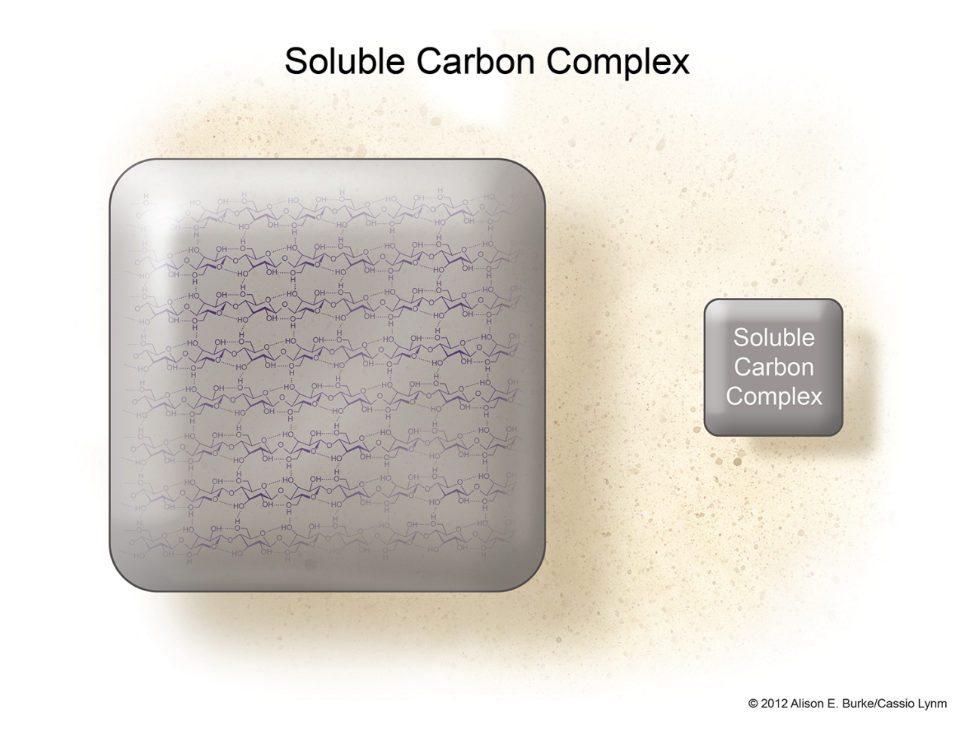
Soluble Carbon Complex
Soluble Carbon Complex is a longer chain carbon molecule.
Soluble Carbon Complex is very stable in the soil environment due to its large size.
Soluble Carbon Complex can:
  Enhance soil aggregation
  Enhance soil structure
  Enhance soil stability.
259

Slide 14
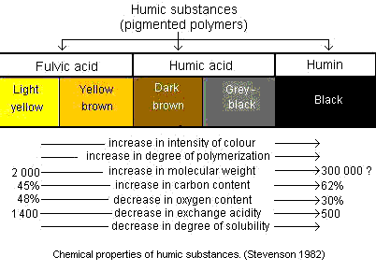
Soil organic matter

Slide 15

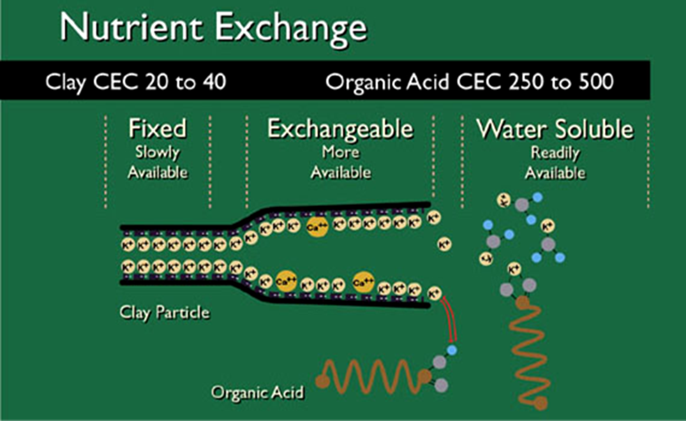
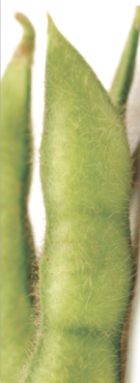

Slide 16
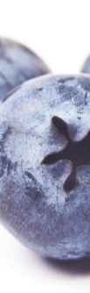
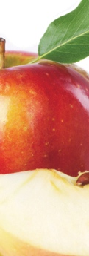
Humus
Is the portion of the organic matter fully decomposed, from which no waste in particular can be identified or differentiated.

Slide 17
Humus
The compounds included under this concept are a heterogeneous group of the following characteristics:
Highly polymerized substances (from aromatic and aliphatic compounds).
Relatively high molecular weight.
Dark colour and hydrophilic colloidal properties.
They are composed mostly of C,O, H, N, S and P.
Humus is formed by two fractions:
Recognizable structure substances, animo acids, polysaccharides, fats and waxes (not humic substances).
Complex amorphous structure substances: fulvic acids, humic acids and humins humic substances.

Slide 18
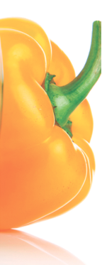
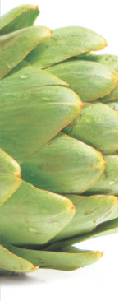
Humus
=
ORGANIC
MATTER
HUMUS
1 kg concentrated powder Humus = 30 tons manure

Slide 19
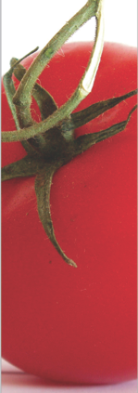
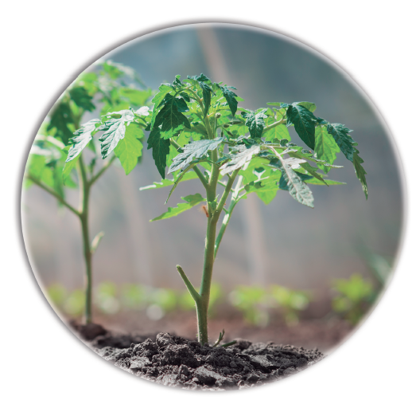
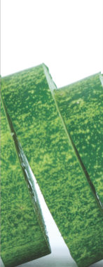
Organic matter micro-organisms - plant relation
BENEFITS
* Organic matter mineralization
* Root growth and morphology
* Enzyme, vitamin and cofactor production
* Soil stability and aggregation
* Growth promoting compounds production
* Nutrient absorption and translocation
* Chelation reaction
* Mineral solubility

Slide 20
IMPORTANCE OF SOM
Organic matter performs many physical, chemical, and biological functions in soil.
Physical functions mainly include enhancement of aggregation, aeration, water movement, and reduction of evaporation and thermal conductivity
Higher organic matter content gives a darker colour. Organic residues accumulated on surface soil may act as mulch.
Organic matter improves soil structure and porosity. Therefore, SOM improves water infiltration, water holding capacity and drainage.

Slide 21
SOM cont…
Humus can hold the equivalent of 80–90% of its weight in moisture and therefore increases the soil’s capacity to withstand drought conditions.
Chemical functions include enhancement of ion exchange, buffering, pedochemical weathering, chelation, and translocation of substances within the soil. (Assignment: Define these terms?)
Humus has the highest number of negative charges on its surface. Humus has, therefore, very high CEC. Humus colloids also contain some positive charges against which anions are adsorbed and exchanged.

Slide 22
SOM cont…
Biological functions include food for soil organisms and a storehouse of nutrients.
Much of the plant nutrients are returned to the soil in the form of organic residues
Upon decomposition, these nutrients are released again to the available nutrient pool of the soil.
OM releases nutrients at a slow pace to the growing roots, and it holds nutrients on their surfaces so that loss of nutrients from a soil rich in organic matter is minimal

Slide 23
Managing SOM
Decline in soil organic matter causes degradation of soil structure, reduction in porosity, water-holding capacity, and aeration and makes the soil compact and erodible.
So, soil organic matter content should be maintained at a level necessary for favourable tilth and fertility
Cultivation opens the soils and oxidizes organic matter. Continuous cropping for a long time seriously declines SOM.
Therefore, addition of plenty of organic residues is needed for sustainable soil fertility.

